Slide 1
Object Oriented Programming Concepts Using C++ & Data Structures

Slide 2
Topics Covered
Selection Sort
Insertion Sort
Bubble Sort
Merge Sort
Quick Sort

Slide 3
Sorting
Sorting refers to arranging data in a particular format. Sorting algorithm specifies the way to arrange data in a particular order. Most common orders are in numerical or lexicographical order.
Adaptive and Non-Adaptive Sorting Algorithm
A sorting algorithm is said to be adaptive, if it takes advantage of already 'sorted' elements in the list that is to be sorted. That is, while sorting if the source list has some element already sorted, adaptive algorithms will take this into account and will try not to re-order them.
A non-adaptive algorithm is one which does not take into account the elements which are already sorted. They try to force every single element to be re-ordered to confirm their sortedness

Slide 4
Bubble Sort
Comparison-based algorithm in which each pair of adjacent elements is compared
Elements are swapped if they are not in order.
This algorithm is not suitable for large data sets as its average and worst case complexity are of Ο(n²) where n is the number of items.
If we have total n elements, then we need to repeat this process for n-1 times.
It is known as bubble sort, because with every complete iteration the largest element in the given array, bubbles up towards the last place or the highest index, just like a water bubble rises up to the water surface.

Slide 5
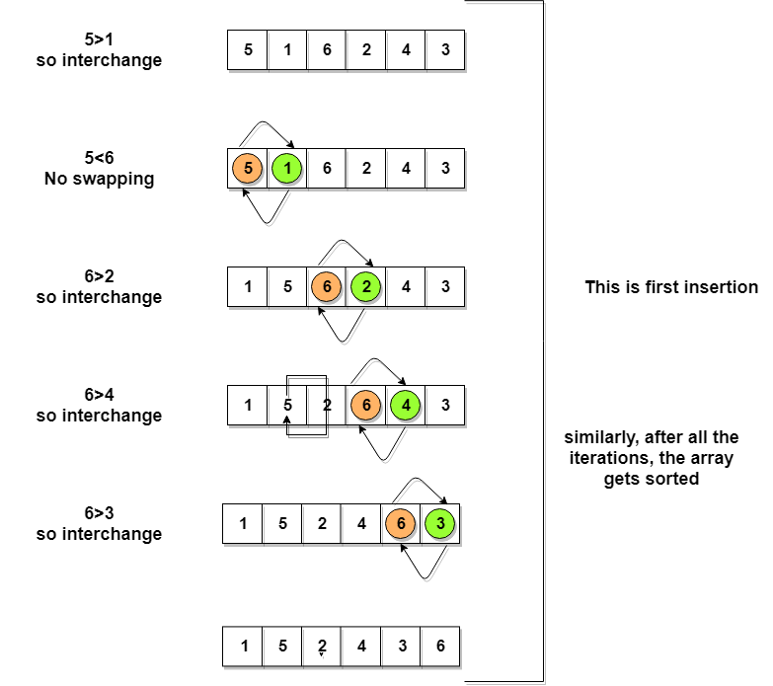
Bubble Sort

Slide 6
Complexity Analysis of Bubble Sort
n-1 comparisons will be done in the 1st pass, n-2 in 2nd pass, n-3 in 3rd pass and so on. So the total number of comparisons will be,
(n-1) + (n-2) + (n-3) + ..... + 3 + 2 + 1
Sum = n(n-1)/2
i.e O(n²)
Worst Case [ Big-O ]: O(n2)
Best Case [Big-omega]: O(n)
Average Case [Big-theta]: O(n2)
best case time complexity will be O(n), it is when the list is already sorted.

Slide 7
Selection Sort
in-place comparison-based algorithm in which the list is divided into two parts, the sorted part at the left end and the unsorted part at the right end.
Initially, the sorted part is empty and the unsorted part is the entire list.
The smallest element is selected from the unsorted array and swapped with the leftmost element, and that element becomes a part of the sorted array. This process continues moving unsorted array boundary by one element to the right.
This algorithm is not suitable for large data sets as its average and worst case complexities are of Ο(n2), where n is the number of items.

Slide 8
Selection Sort
This algorithm will first find the smallest element in the array and swap it with the element in the first position, then it will find the second smallest element and swap it with the element in the second position, and it will keep on doing this until the entire array is sorted.
It is called selection sort because it repeatedly selects the next-smallest element and swaps it into the right place.

Slide 9
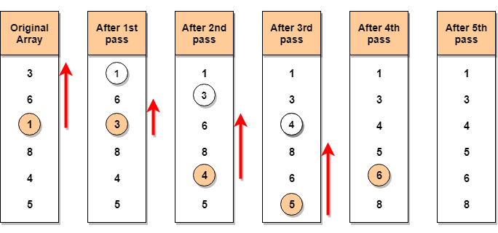
Selection Sort

Slide 10
Complexity Analysis of Selection Sort
Selection Sort requires two nested for loops to complete itself, one for loop is in the function selectionSort, and inside the first loop we are making a call to another function indexOfMinimum, which has the second(inner) for loop.
Hence for a given input size of n, following will be the time and space complexity for selection sort algorithm:
Worst Case [ Big-O ]: O(n²)
Best Case [Big-omega]: O(n²)
Average [Big-theta]: O(n²)

Slide 11
Insertion Sort
in-place comparison-based sorting algorithm. Here, a sub-list is maintained which is always sorted. For example, the lower part of an array is maintained to be sorted.
An element which is to be 'insert'ed in this sorted sub-list, has to find its appropriate place and then it has to be inserted there. Hence the name, insertion sort.
The array is searched sequentially and unsorted items are moved and inserted into the sorted sub-list (in the same array).
This algorithm is not suitable for large data sets as its average and worst case complexity are of Ο(n²), where n is the number of items.

Slide 12
Insertion Sort
in-place comparison-based sorting algorithm. Here, a sub-list is maintained which is always sorted. For example, the lower part of an array is maintained to be sorted.
An element which is to be 'insert'ed in this sorted sub-list, has to find its appropriate place and then it has to be inserted there. Hence the name, insertion sort.
The array is searched sequentially and unsorted items are moved and inserted into the sorted sub-list (in the same array).
This algorithm is not suitable for large data sets as its average and worst case complexity are of Ο(n²), where n is the number of items.

Slide 13
Insertion Sort

Slide 14
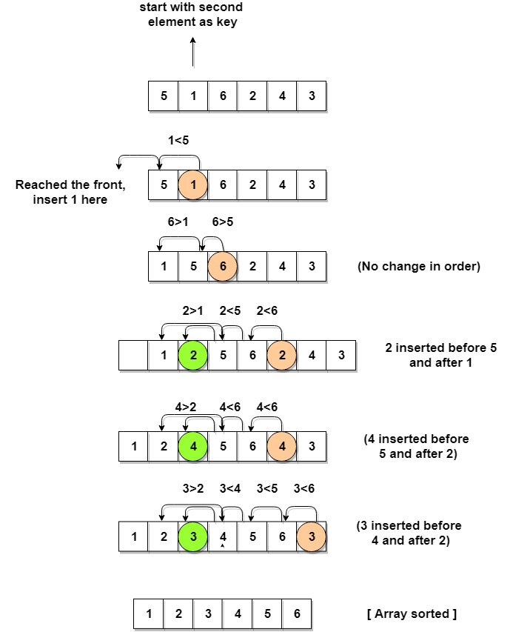
Insertion Sort

Slide 15
Complexity Analysis of Insertion Sort
Even though insertion sort is efficient, still, if we provide an already sorted array to the insertion sort algorithm, it will still execute the outer for loop, thereby requiring n steps to sort an already sorted array of n elements, which makes its best case time complexity a linear function of n.
Worst Case Time Complexity [ Big-O ]: O(n²)
Best Case Time Complexity [Big-omega]: O(n)
Average Time Complexity [Big-theta]: O(n²)

